Slide 1
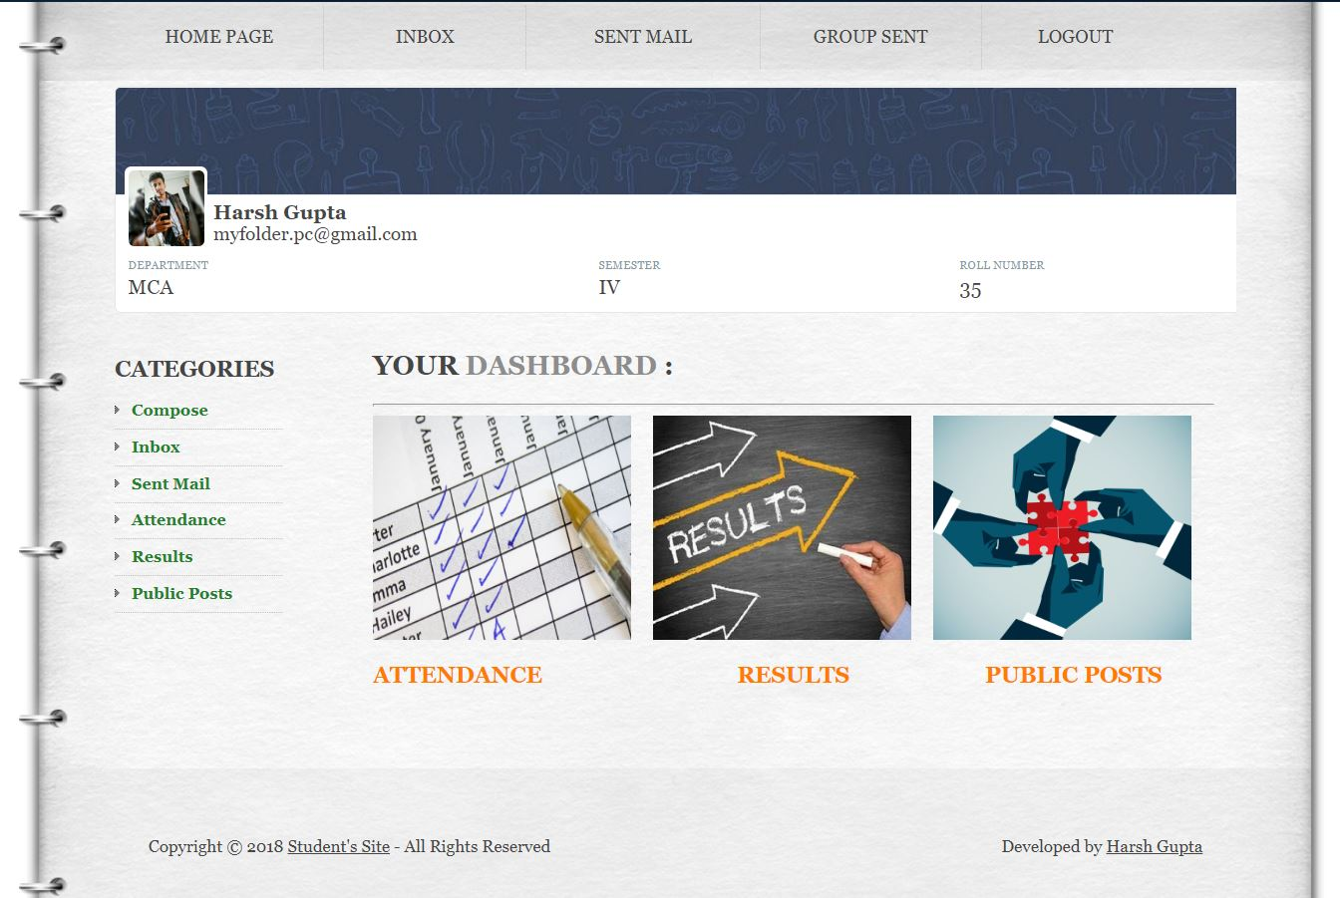
Student Portal
The Focus is You.
- Harsh Gupta
- Shikha Agarwal
- Monika Bachani
- Ankit Bansal

Slide 2
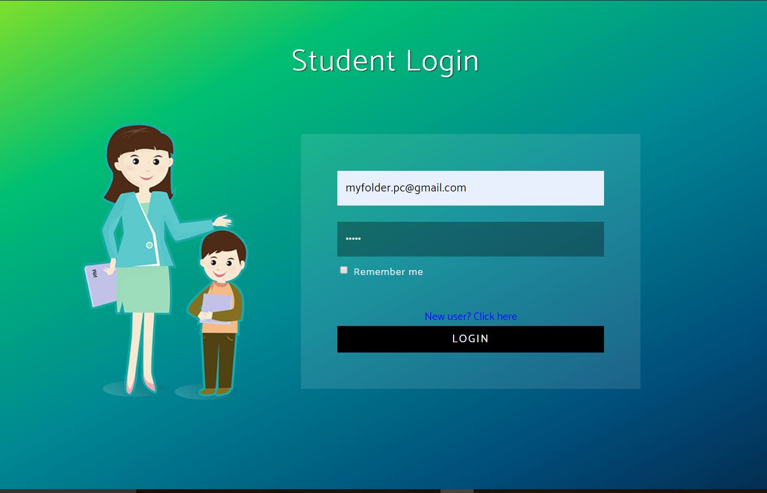
Table Of Contents
Introduction
About Project
Features
Project Modules
Attendance Management
Result Management
Public Posts
Email System
Technical Description
Hardware Requirements
Technology Used

Slide 3
Introduction
The Student’s Portal is an informative portal for the students that allows students or their parents to get the information about the student activities and performance in the college.
The student portal allows one to view –
Student’s Attendance (An Attendance Management System)
Student’s Results (A Result Management System)
Apart from this, it also has some additional features that can make student’s task much easier such as :-
Public Posts (A platform where documents can be exchanged)
Email System (Allows one to send college related emails)

Slide 5
Key Features -
Attendance Management System.
A platform that can manage the attendance of the students online.
Result Management System.
A platform that allows one to view the results.
Sharing Platform.
A common document exchange platform.
Email System.
A GMAIL-like email system.

Slide 6
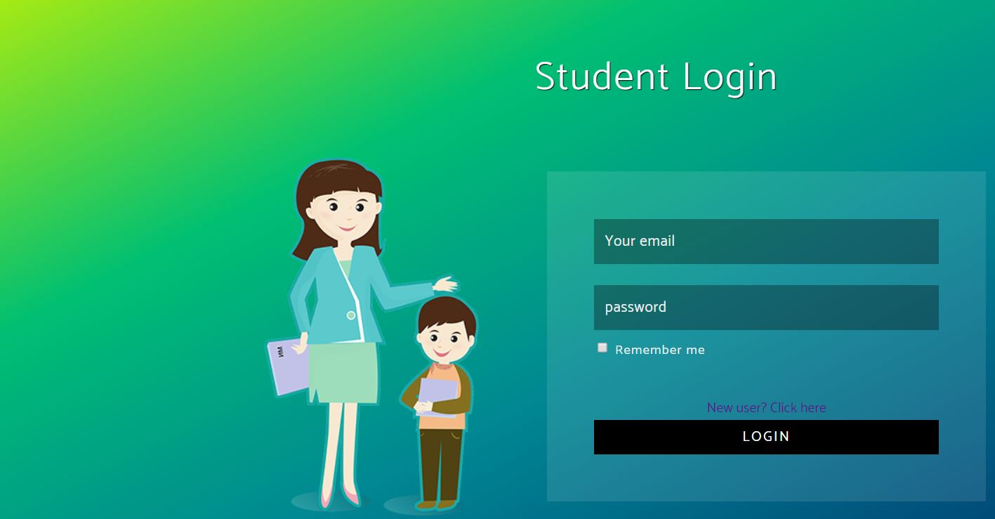
Login Panel
A Login and Registration Panel
It gives the Login panel for both STUDENT and ADMIN.
Registration panel for students.

Slide 7
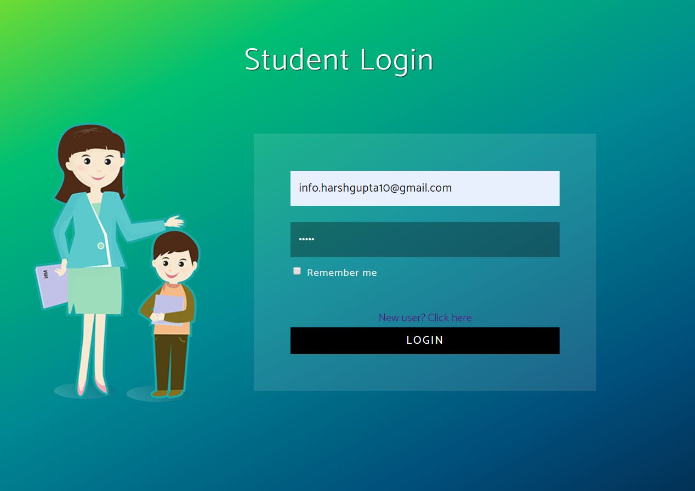

Slide 8
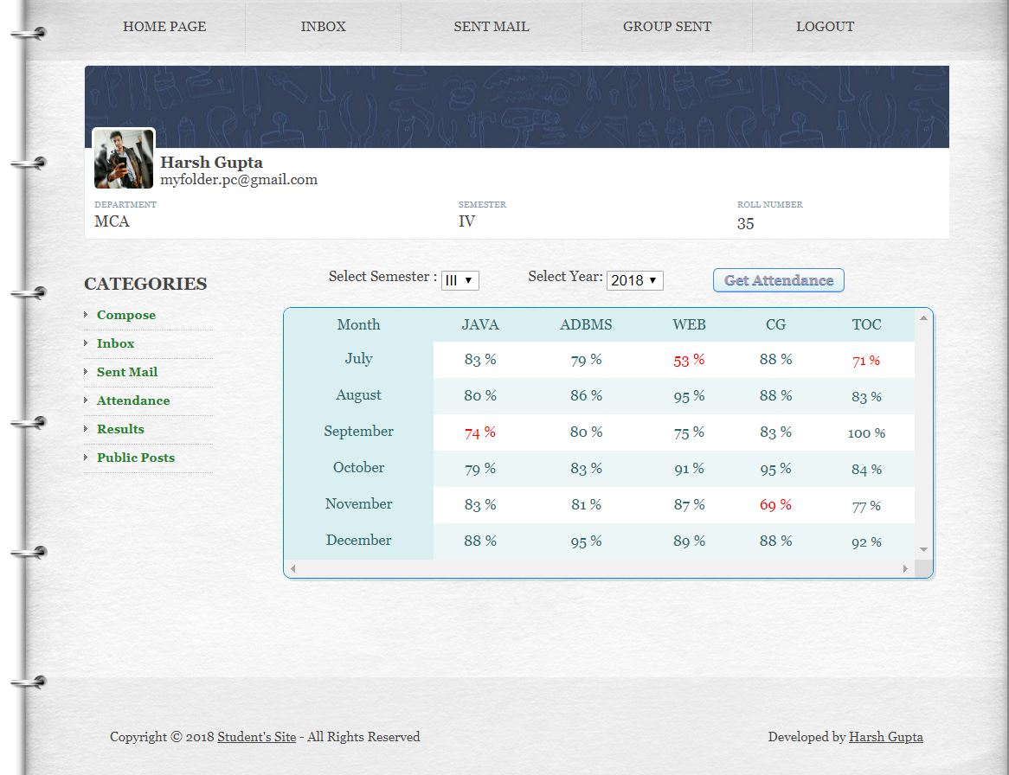
Attendance
A Dynamic Attendance Management System
This module allows one to get the complete attendance details of the student.
It shows the month-wise attendance of each and every subjects of a particular semester.
Features :-
Red-Alert for low attendance
Fetches Semester-Wise attendance
Displays month-wise attendance for each subject.
Completely Dynamic

Slide 10
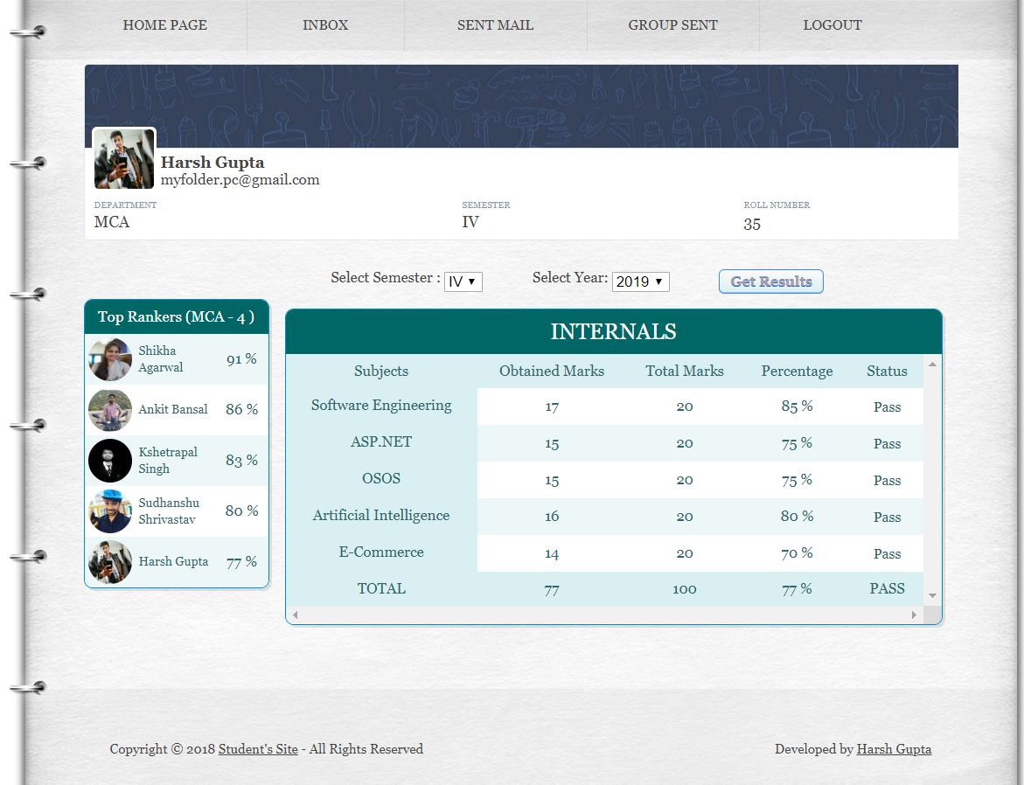
Results
A Dynamic Result Management System
This module allows one to get the examination results of the student.
It displays the obtained marks, total marks, percentage, and the status of the result.
Features :-
Red-Alert for low result.
Display the List of TOP 5 RANKERS.
Fetches result semester wise.
Displays the Pass and Fail status based on total percentage.
Completely Dynamic

Slide 12
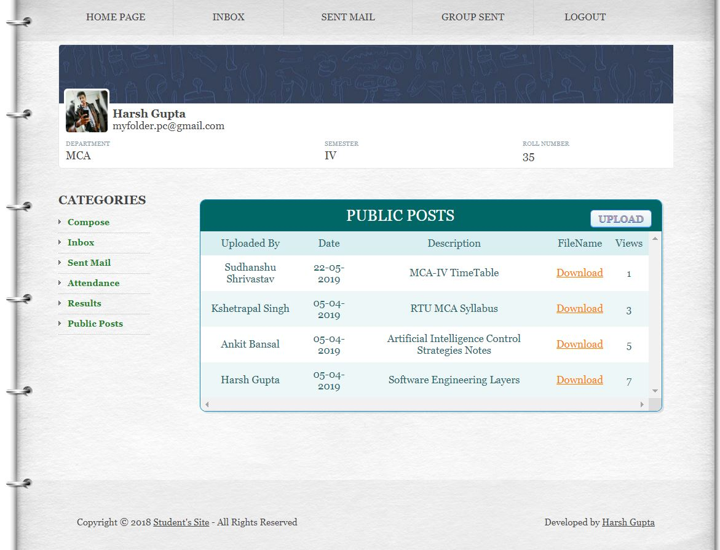
Public Posts
A Document Exchange Platform
This module allows one to share any documents with others and also can view the documents shared by others.
One can upload any documents and can make it public.
Features :-
Displays documents in reverse chronological order.
Shows the number of views/downloads.
Assign unique names to documents to avoid clashing.

Slide 14
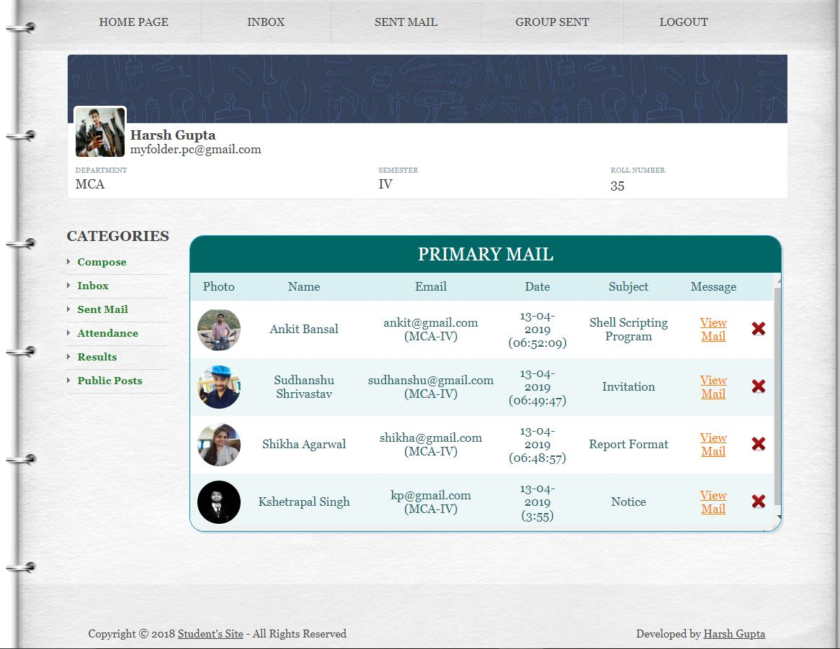
Email
A Gmail-like Email System
A email system that allows one to send or receive emails from registered members.
You can COMPOSE , READ, DELETE the emails.
Features :-
COMPOSE a email
INBOX for reading the received emails.
SENT MAIL for viewing the mail sent.
TRASH the unwanted emails.
Displays the Photo, Name, Email, Date, Time, Semester, Department of the sender/receiver.

Slide 16
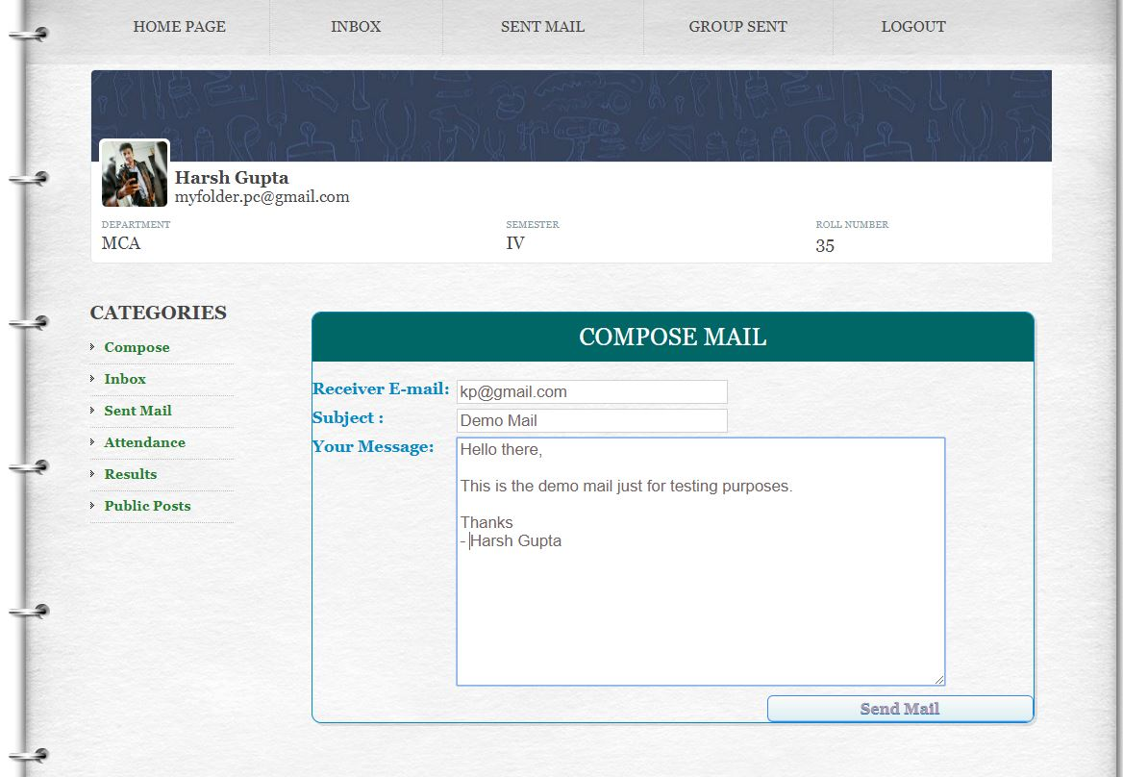

Slide 17


Technical Description
Hardware Requirements
Pentium or later processor.
Minimum 512MB of RAM.
Best Compatible with GOOGLE CHROME.
Technology Used
ASP . NET
ADO . NET
MS ACCESS Database.
ODBC Data Source.

Slide 18
THANK YOU!
Developed By
Harsh Gupta
Shikha Agarwal
Monika Bachani

